Slide 1

Trees
C H A P T E R 16
I like trees because they seem more resigned to the way they have to live than other things do.
—Willa Cather, O Pioneers!, 1913
16.1 Family trees
16.2 Binary search trees
16.3 Balanced trees
16.4 Implementing maps using BSTs
16.5 Partially ordered trees

Slide 2
Implementation Strategies for Maps
Flashback
There are several strategies you might choose to implement the map operations get and put. Those strategies include:
1. Linear search. Keep track of all the key/value pairs in a vector. In this model, both the get and put operations run in O(N) time.
2. Binary search. If you keep the vector sorted by the key, you can use binary search to find the key. Using this strategy improves the performance of get to O(logN) and put is still O(N).
3. Table lookup in a grid. In the two-character code example, you can store the state names in a 26 X 26 Grid<string> in which the first and second indices correspond to the two letters in the code. Because you can now find any code in a single step, this strategy is O(1), although this performance comes at a cost in memory space (only 50/676 occupied). This is the idea of hashing.

Slide 3
Limitations of Hashing
In the last chapter, We have seen how hashing makes it possible to implement the get and put operations for a map in O(1) time.
Despite its extraordinary efficiency, hashing is not always the best strategy for implementing maps, because of the following limitations:
Hash tables depend on being able to compute a hash function on some key. Expanding the hash-function idea so that it applies to types other than strings is subtle.
Using the range-based for on hash tables does not deliver the keys in any sensible order. Even when the keys have a natural order (such as the lexicographic order used with strings), the hash table code for iteration cannot take advantage of that fact.
The goal now is to explore another representation that supports iterating through the elements in order.

Slide 4
The foreach Statement
One of the common operations that clients need to perform when using a collection is to iterate through the elements.
While it is easy to implement iteration for vectors and grids using for loops, it is less clear how you would do the same for other collection types. The modern approach to solving this problem is to use a general tool called an iterator that delivers the elements of the collection, one at a time.
C++11 uses a range-based for statement to simplify iterators:
The Stanford libraries implement the same idea like this:
for (string key : map) {
. . . code to process that key . . .
}
foreach (string key in map) {
. . . code to process that key . . .
}

Slide 5
Iterator Order
When you look at the documentation for an iterator, one of the important things to determine is whether the collection class specifies the order in which elements are generated. The Stanford C++ libraries make the following guarantees:
Iterators for arrays operate in index order.
Iterators for grids operate in row-major order, which means that the iterator runs through every element in row 0, then every element in row 1, and so on.
Iterators for the Map class deliver the keys in the order imposed by the standard comparison function for the key type; iterators for the HashMap class return keys in a seemingly random order.
Iterators for the Set class deliver the elements in the order imposed by the standard comparison function for the value type; the HashSet class is unordered.
Iterators for lexicons always deliver words in alphabetical order.

Slide 6
Analyzing the Failure of Sorted Arrays
One of the strategies outlined previously for implementing a map was to use a sorted array to hold the key-value pairs. Given that representation, binary search made it possible to find a key in O(logN) time.
The problem with the sorted array strategy was that inserting a new key required O(N) time to maintain the order.
In the editor buffer, linked lists solved the insertion problem. Unfortunately, turning a sorted array into a linked list makes it impossible to apply binary search because there is no way to find the middle element in O(1) time.
But what if you could point to the middle element in a linked list? That question gives rise to a new structure called a tree, which provides the key to implementing a map with O(logN) performance for both the get and put operations.

Slide 7
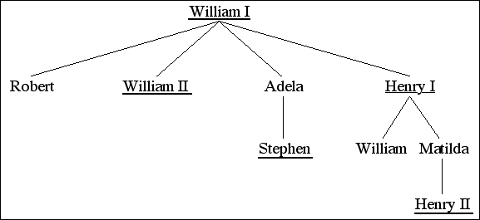
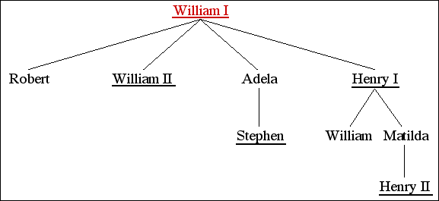
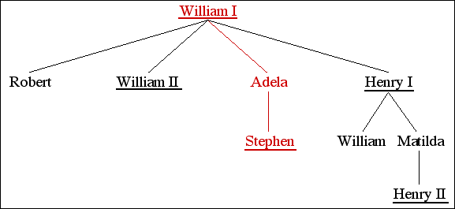
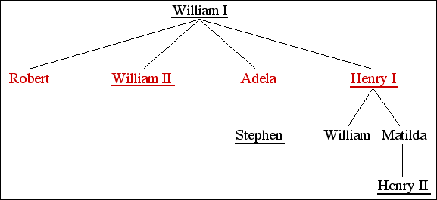
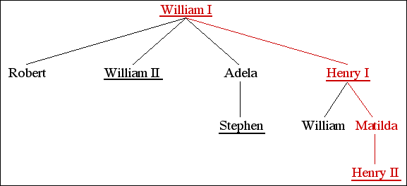
Trees
In the text, the first example used to illustrate tree structures is the royal family tree of the House of Normandy:
This example is useful for defining terminology:
William I is the root of the tree.
Adela is a child of William I and the parent of Stephen.
Robert, William II, Adela, and Henry I are siblings.
Henry II is a descendant of William I, Henry I, and Matilda.
William I is an ancestor of everyone else in this tree.

Slide 8
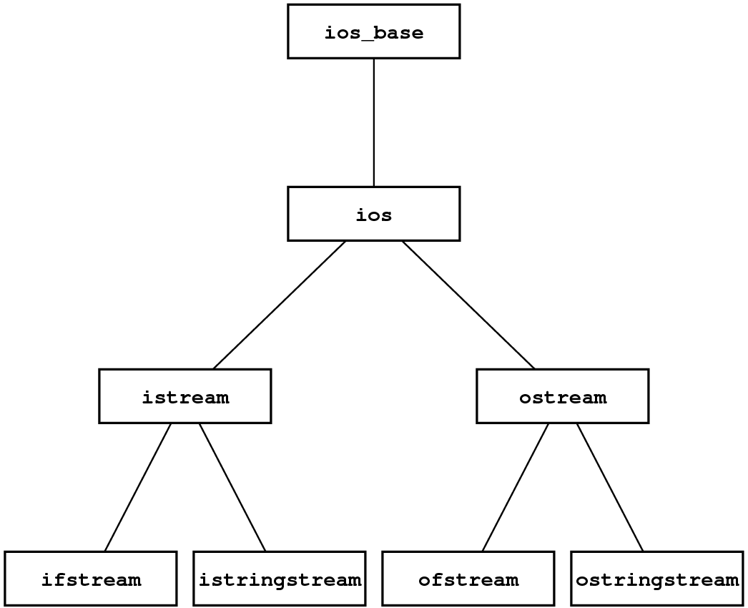
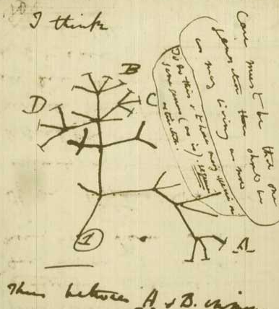
Trees Are Everywhere
Trees appear in many familiar contexts beyond family trees. The picture at the right comes from Darwin’s notebooks and shows his early conception of an evolutionary tree.
Trees also form the basis for the class hierarchies used in object-oriented programming languages like Python and C++.
In each of these contexts, trees begin with a single root node and then branch outward repeatedly to encompass any other nodes in the tree.

Slide 9
Trees as a Recursive Data Structure
If you think about trees as a programmer, the following definition is extremely useful:
A tree is a pointer to a node.
A node is a structure that contains some number of trees.
Although this definition is clearly circular, it is not necessarily infinite, either because
Tree pointers can be NULL indicating an empty tree.
Nodes can contain an empty list of children.
In C++, programmers typically define a structure or object type to represent a node and then use an explicit pointer type to represent the tree.
struct TreeNode {
string key;
Vector<TreeNode *> children;
};

Slide 10
Binary Search Trees
The tree that supports the implementation of the Map class is called a binary search tree (or BST for short). Each node in a BST has exactly two subtrees: a left subtree that contains all the nodes that come before the current node and a right subtree that contains all the nodes that come after it. Either or both of these subtrees may be NULL.
The classic example of a binary search tree uses the names from Walt Disney’s Snow White and the Seven Dwarves:

Slide 11
The motivation behind Binary Search Trees
The idea is to combine the linked list data structure (for easier insertion/deletion) and the binary search algorithm (for faster search).

Slide 12
A Simple BST Implementation
To get a sense of how binary search trees work, it is useful to start with a simple design in which keys are always strings.
Each node in the tree is then a structure containing a key and two subtrees, each of which is either NULL or a pointer to some other node. This design suggests the following definition:
The code for finding a node in a tree begins by comparing the desired key with the key in the root node. If the strings match, you’ve found the correct node; if not, you simply call yourself recursively on the left or right subtree depending on whether the key you want comes before or after the current one.
struct BSTNode {
string key;
BSTNode *left, *right;
};

Slide 13
Exercise: Building a Binary Search Tree
Diagram the BST that results from executing the following code:
colors
Node *colors = NULL;
insertNode(colors, "red");
insertNode(colors, "orange");
insertNode(colors, "yellow");
insertNode(colors, "green");
insertNode(colors, "blue");
insertNode(colors, "indigo");
insertNode(colors, "violet");
red
orange
yellow
green
violet
blue
indigo

Slide 14
A Simple BST Implementation
/*
* Type: Node
* ----------
* This type represents a node in the binary search tree.
*/
struct Node {
string key;
Node *left, *right;
};
/*
* Function: findNode
* Usage: Node *node = findNode(t, key);
* -------------------------------------
* Returns a pointer to the node in the binary search tree t than contains
* a matching key. If no such node exists, findNode returns NULL.
*/
Node *findNode(Node *t, string key) {
if (t == NULL) return NULL;
if (key == t->key) return t;
if (key < t->key) {
return findNode(t->left, key);
} else {
return findNode(t->right, key);
}
}

Slide 15
A Simple BST Implementation
/*
* Type: Node
* ----------
* This type represents a node in the binary search tree.
*/
struct Node {
string key;
Node *left, *right;
};
/*
* Function: findNode
* Usage: Node *node = findNode(t, key);
* -------------------------------------
* Returns a pointer to the node in the binary search tree t than contains
* a matching key. If no such node exists, findNode returns NULL.
*/
Node *findNode(Node *t, string key) {
if (t == NULL) return NULL;
if (key == t->key) return t;
if (key < t->key) {
return findNode(t->left, key);
} else {
return findNode(t->right, key);
}
}
/*
* Function: insertNode
* Usage: insertNode(t, key);
* --------------------------
* Inserts the specified key at the appropriate location in the
* binary search tree rooted at t. Note that t must be passed
* by reference, since it is possible to change the root.
*/
void insertNode(Node * & t, string key) {
if (t == NULL) {
t = new Node;
t->key = key;
t->left = t->right = NULL;
return;
}
if (key == t->key) return;
if (key < t->key) {
insertNode(t->left, key);
} else {
insertNode(t->right, key);
}
}

Slide 16
Removing Nodes in Binary Search Trees
For a leaf node (with no children), replace the pointer to the node with a NULL pointer;
If either child of the node you want to remove is NULL, replace it with its non-NULL child;
If you try to remove a node with both a left and a right child, replace it with the rightmost node in the left subtree or the leftmost node in the right subtree.

Slide 17
Traversal Strategies
It is easy to write a function that performs some operation for every key in a binary search tree, because recursion makes it simple to apply that operation to each of the subtrees.
The order in which keys are processed depends on when you process the current node with respect to the recursive calls:
If you process the current node before either recursive call, the result is a preorder traversal.
If you process the current node after the recursive call on the left subtree but before the recursive call on the right subtree, the result is an inorder traversal. In the case of the simple BST implementation that uses strings as keys, the keys will appear in lexicographic order.
If you process the current node after completing both recursive calls, the result is a postorder traversal. Postorder traversals are particularly useful if you are trying to free all the nodes in a tree.

Slide 18
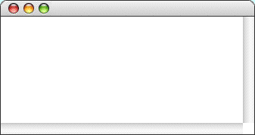
Exercise: Preorder Traversal
void preorderTraversal(Node *t) {
if (t != null) {
cout << t->key << endl;
preorderTraversal(t->left);
preorderTraversal(t->right);
}
}
PreorderTraversal
Grumpy
Doc
Bashful
Dopey
Sleepy
Happy
Sneezy

Slide 19
Exercise: Inorder Traversal
void inorderTraversal(Node *t) {
if (t != null) {
inorderTraversal(t->left);
cout << t->key << endl;
inorderTraversal(t->right);
}
}
InorderTraversal
Bashful
Doc
Dopey
Grumpy
Happy
Sleepy
Sneezy

Slide 20
Exercise: Postorder Traversal
void postorderTraversal(Node *t) {
if (t != null) {
postorderTraversal(t->left);
postorderTraversal(t->right);
cout << t->key << endl;
}
}
PostorderTraversal
Bashful
Dopey
Doc
Happy
Sneezy
Sleepy
Grumpy

Slide 21
A Question of Balance
Ideally, a binary search tree containing the names of Disney’s seven dwarves would look like this:
If, however, you happened to enter the names in alphabetical order, this tree would end up being a simple linked list in which all the left subtrees were NULL and the right links formed a simple chain. Algorithms on that tree would run in O(N) time instead of O(logN) time.
A binary search tree is balanced if the height of its left and right subtrees differ by at most one and if both of those subtrees are themselves balanced.

Slide 24
Tree-Balancing Algorithms
The AVL algorithm was the first tree-balancing strategy and has been superseded by newer algorithms that are more effective in practice. These algorithms include:
Red-black trees
2-3 trees
AA trees
Fibonacci trees
Splay trees
At this point in your study of computer science, the important thing to know is that it is possible to keep a binary tree balanced as you insert nodes, thereby ensuring that lookup operations run in O(logN) time. If you get really excited about this kind of algorithms, you’ll have the opportunity to study them in more detail in the later Data Structures and Algorithms course.

Slide 25
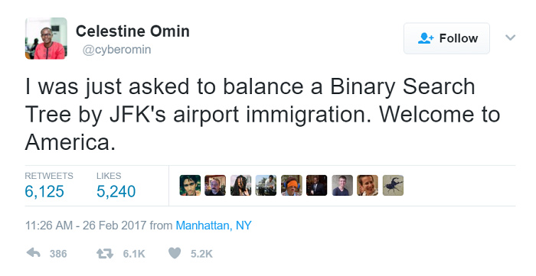

Slide 26
Implementing Maps Using BSTs
The binary search tree structure makes it possible to define a Map class in which get and put operate in O(logN) time while allowing iteration to proceed in order.
The following changes are required to implement the Map class:
The BSTNode structure must be expanded to include a value field.
The class must include template parameters for both the key and value types.
The implementation must include the methods that define the complete Map interface, such as size, isEmpty, clear, and containsKey.
The implementation must overload operator[] to support the associative array syntax.

Slide 27
Priority Queues
Besides implementing maps, trees come up in many other programming contexts.
A priority queue is a queue in which the order in which elements are dequeued depends on a numeric priority.
They are essential to both Dijkstra’s and Kruskal’s algorithms (examples of some very important graph algorithms), therefore, making them efficient improves performance.
If you implement them in the obvious way using either arrays or linked lists, priority queues require O(N) time (Exercise 8 from Chapter 14).
The standard algorithm for implementing priority queues uses a data structure called a partially ordered tree, which makes it possible to implement priority queue operations in O(log N) time.

Slide 28
Partially Ordered Trees
A partially ordered tree is a special class of binary tree (but not a binary search tree) with these additional properties:
The tree is complete, i.e., it is completely balanced, and each level of the tree is filled as far to the left as possible.
The root node of the tree has higher priority than the root of either of its subtrees, which are also partially ordered trees.
A heap is an array-based data structure that simulates the operation of a partially ordered tree. (The heap data structure bears no relationship to the pool of unused memory “heap” available for dynamic allocation.)
The heap stores the nodes in a partially ordered tree simply by counting off the nodes, level by level, from left to right, making it simple to implement tree operations:
parentIndex(n) is always given by (n - 1) / 2
leftChildIndex(n) is always given by 2 * n + 1
rightChildIndex(n) is always given by 2 * n + 2

Slide 29
Exercise: Partially Ordered Trees
Insert in order:
17
93
20
42
68
11
17
The heap:
17

Slide 30
Exercise: Partially Ordered Trees
Insert in order:
17
93
20
42
68
11
17
93
The heap:
17
93

Slide 31
Exercise: Partially Ordered Trees
Insert in order:
17
93
20
42
68
11
17
93
20
The heap:
17
93
20

Slide 32
Exercise: Partially Ordered Trees
Insert in order:
17
93
20
42
68
11
17
93
20
42
The heap:
17
93
20
42

Slide 33
Exercise: Partially Ordered Trees
Insert in order:
17
93
20
42
68
11
17
93
20
42
The heap:
17
42
20
93

Slide 34
Exercise: Partially Ordered Trees
Insert in order:
17
93
20
42
68
11
17
42
20
93
68
The heap:
17
42
20
93
68

Slide 35
Exercise: Partially Ordered Trees
Insert in order:
17
93
20
42
68
11
17
42
20
93
68
11
The heap:
17
42
20
93
68
11

Slide 36
Exercise: Partially Ordered Trees
Insert in order:
17
93
20
42
68
11
17
42
20
93
68
11
The heap:
17
42
11
93
68
20

Slide 37
Exercise: Partially Ordered Trees
Insert in order:
17
93
20
42
68
11
17
42
11
93
68
20
The heap:
11
42
17
93
68
20

Slide 38
Exercise: Partially Ordered Trees
Insert in order:
17
93
20
42
68
11
Dequeue the top priority element
11
42
17
93
68
20
The heap:
11
20
42
17
93
68
20

Slide 39
Exercise: Partially Ordered Trees
Insert in order:
17
93
20
42
68
11
Dequeue the top priority element
11
20
42
17
93
68
The heap:
17
42
20
93
68

Slide 40
The End

